Slide 1
Yoga Workshop
Team :
Olha Mykolaichuk
Natalia Konopińska
Joanna Greschutz
Wojciech Piórkowski

Slide 2
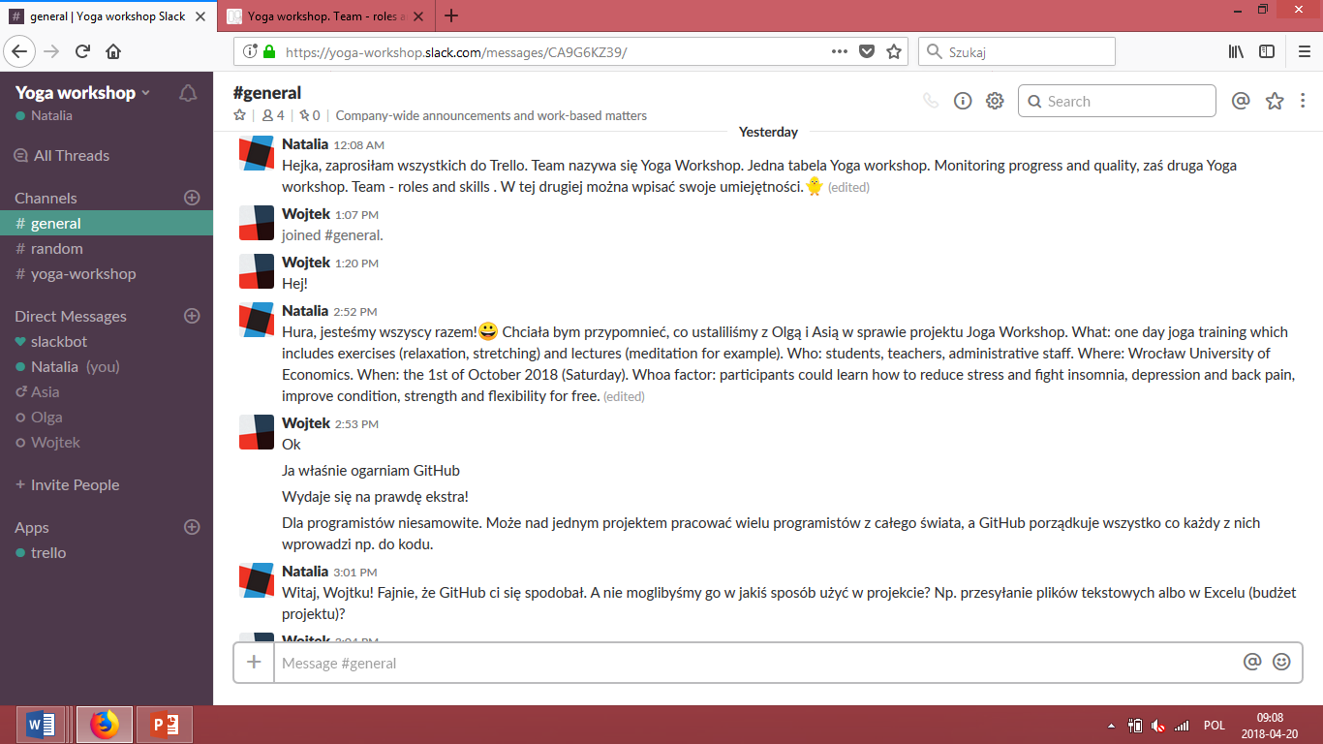
1. Yoga Workshop. Project definition
Objective: promotion of healthy lifestyle.
What: one day yoga training which includes exercises (relaxation, stretching) and lectures (meditation).
Who: students, teachers, administrative staff.
Where: Wroclaw University of Economics.
When: the 29 st of September 2018 (Saturday).
Whoa factor: participants could learn how to reduce stress and fight insomnia, depression and back pain, improve condition, strength and flexibility for free.

Slide 3
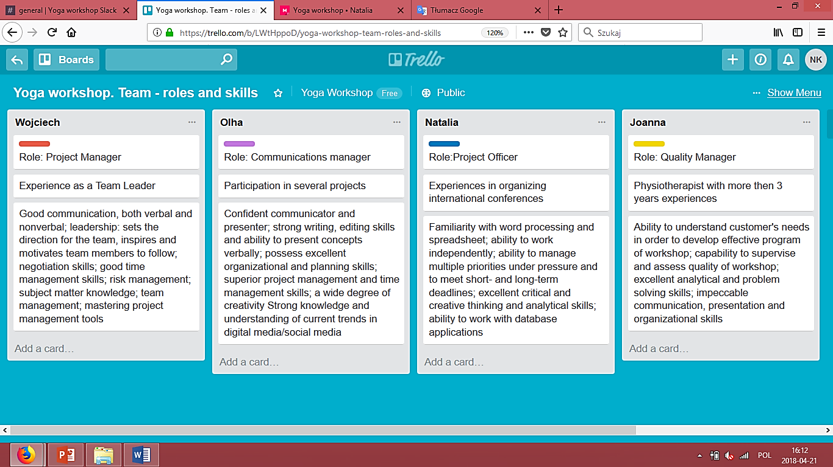
2. Yoga Workshop team - roles and skills

Slide 4
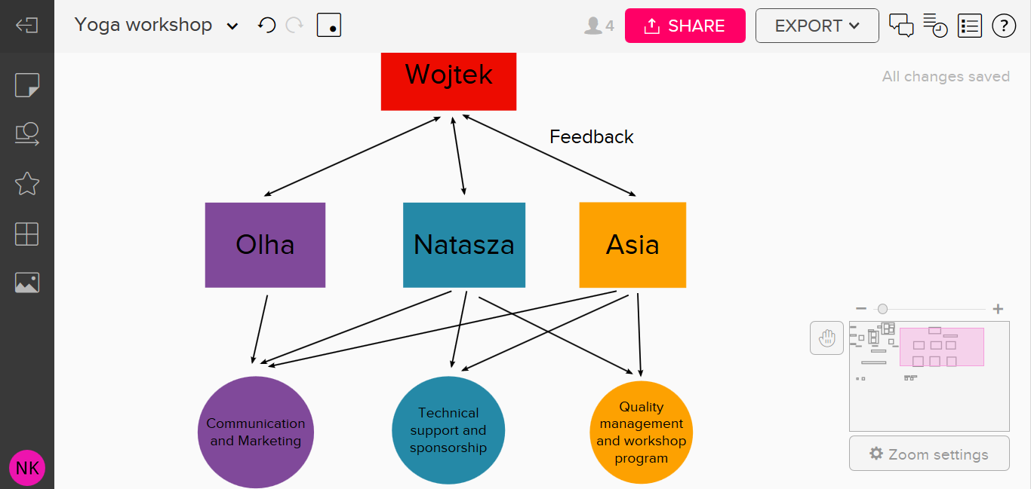
2. Yoga Workshop team - roles and skills c.d.

Slide 5
3. Yoga Workshop plan with tasks and owners

Slide 6
4. Budget
sdasdasf
vfadfavdv

Slide 7
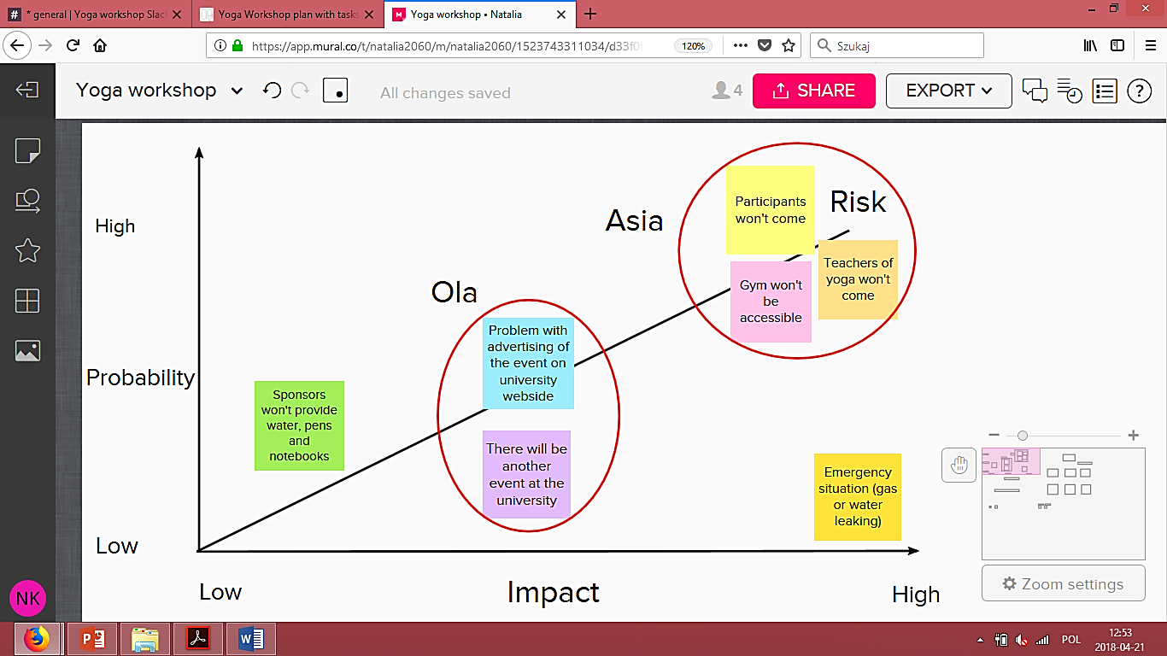
5. Risks analysis

Slide 8
5. Risks analysis. Risk Register
Description: Gym won’t be accessible
Owner: Asia
Risk Type: technical
Probability of Occurrence: Medium
Severity of Effect : Medium / High
Mitigation Plan: Ola should find and reserve different accommodation. Make sure that participants of Yoga Workshop receive information about changing of localisation. Notify other members of team. Fill Risk Register.

Slide 9
6. Identification of stakeholders and possible changes

Slide 10
7. Plan for monitoring progress and quality

